Slide 1
Lecture 3: ‘Slow and steady wins the race’: Effect of beta blockers and analgesics on exercise training and performance.

Slide 2
TYPES OF PERFORMANCE ENHANCING DRUGS
Caffeine
Amphetamines
Cocaine
Steroids
Beta-2 agonists
Growth Hormone
Alcohol
Beta Blockers
Cannabinoids
STIMULANTS
BUILD MUSCLE
RELAXANTS
PERFORMANCE
Diuretics
MASK DRUG
USE
Diuretics
REDUCE
WEIGHT
EPO
INCREASE
OXYGEN
Narcotics
NSAIDS
(Ibuprofen)
MASK
PAIN

Slide 3
Pharmacologic Agents
IOC-banned substance categories
Stimulants
Narcotic analgesics
Androgenic-anabolic steroids
β-Blockers
Diuretics
Peptide hormones and analogs
Substances that alter urine sample integrity

Slide 4
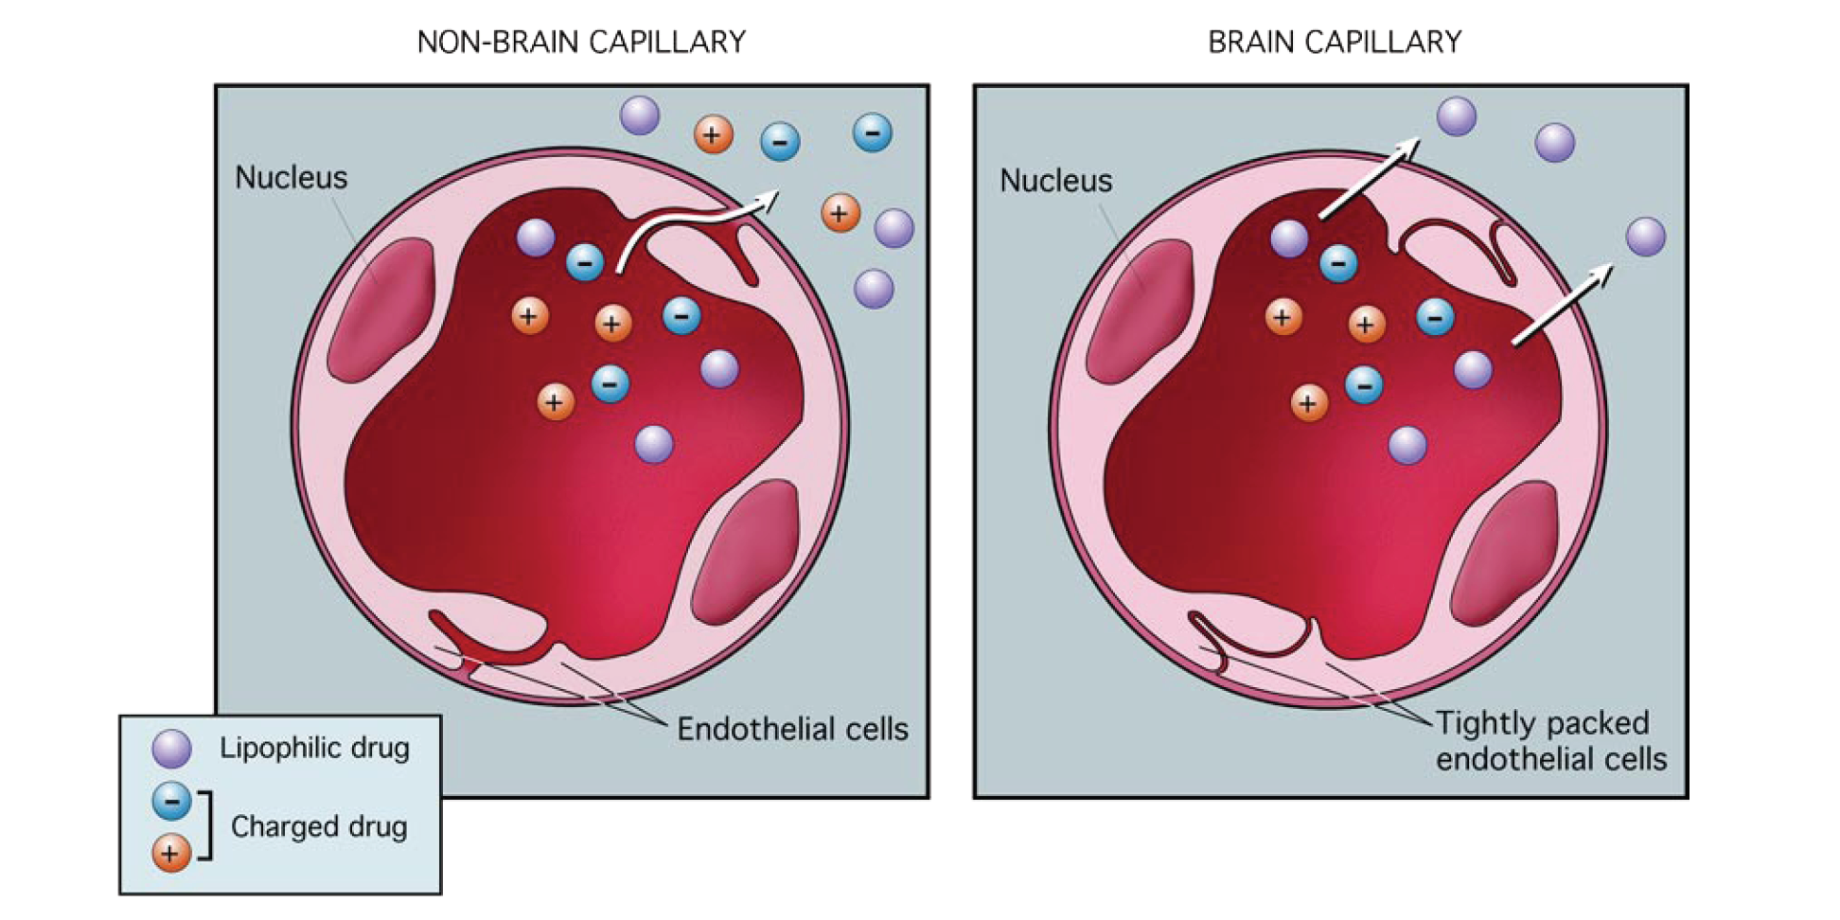

Blood Brain Barrier

Slide 5
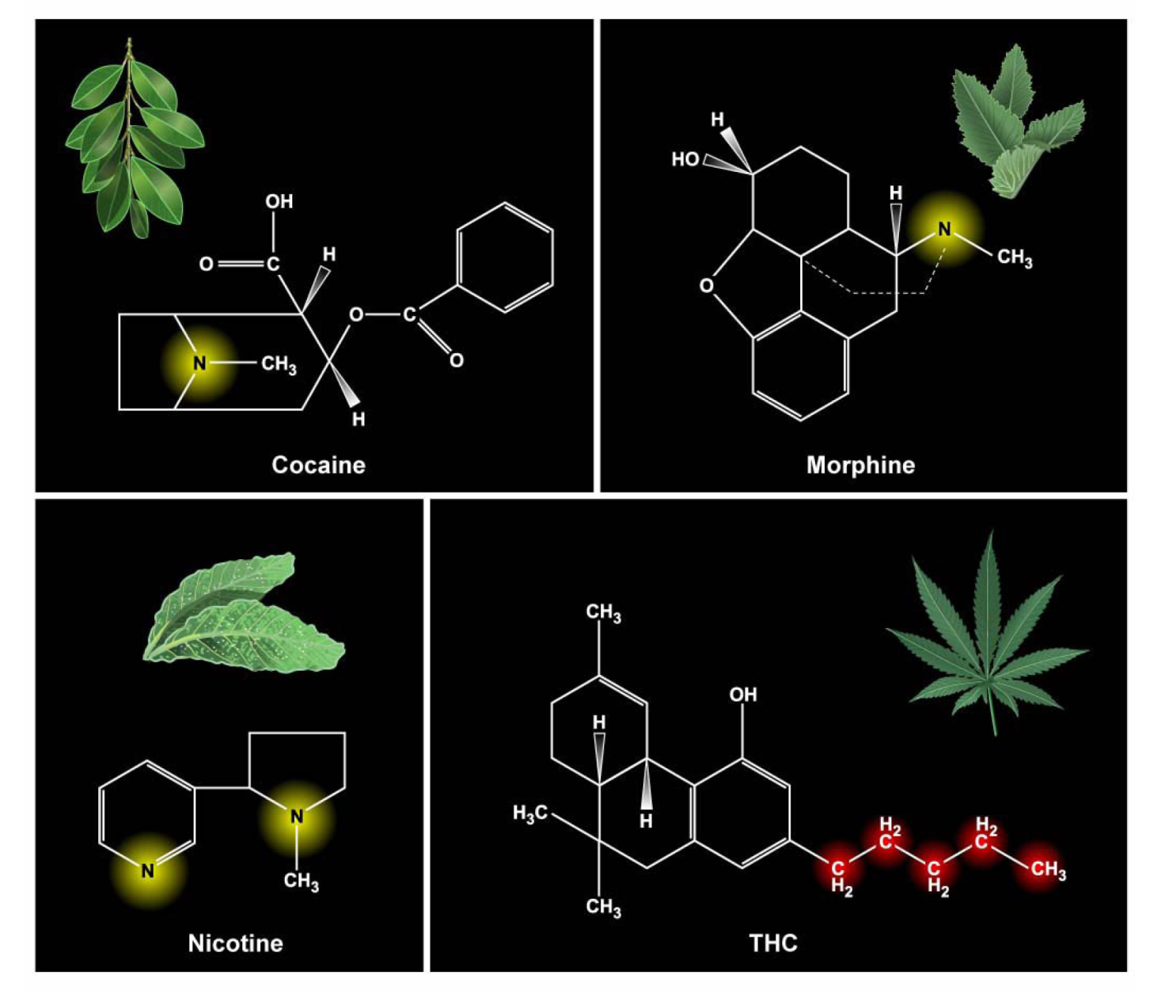
Compounds are all lipophyllic or fat loving or water hating.
They will readily cross the blood brain barrier.
Hence the psychoactive effects.

Slide 6
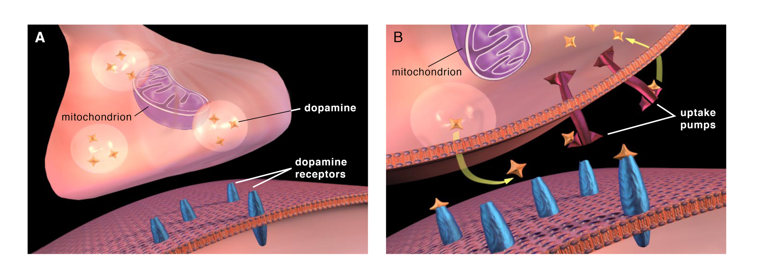
Dopamine

Slide 7
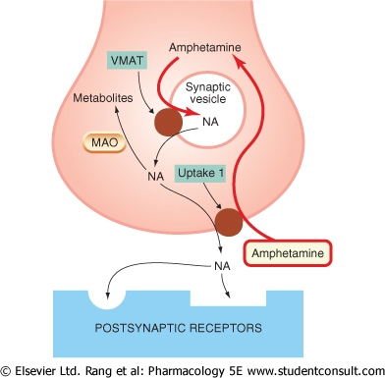
Inhibits uptake
Increase in NA,
& dopamine
Dopamine
Cocaine
Dopamine
Dopamine

Slide 8
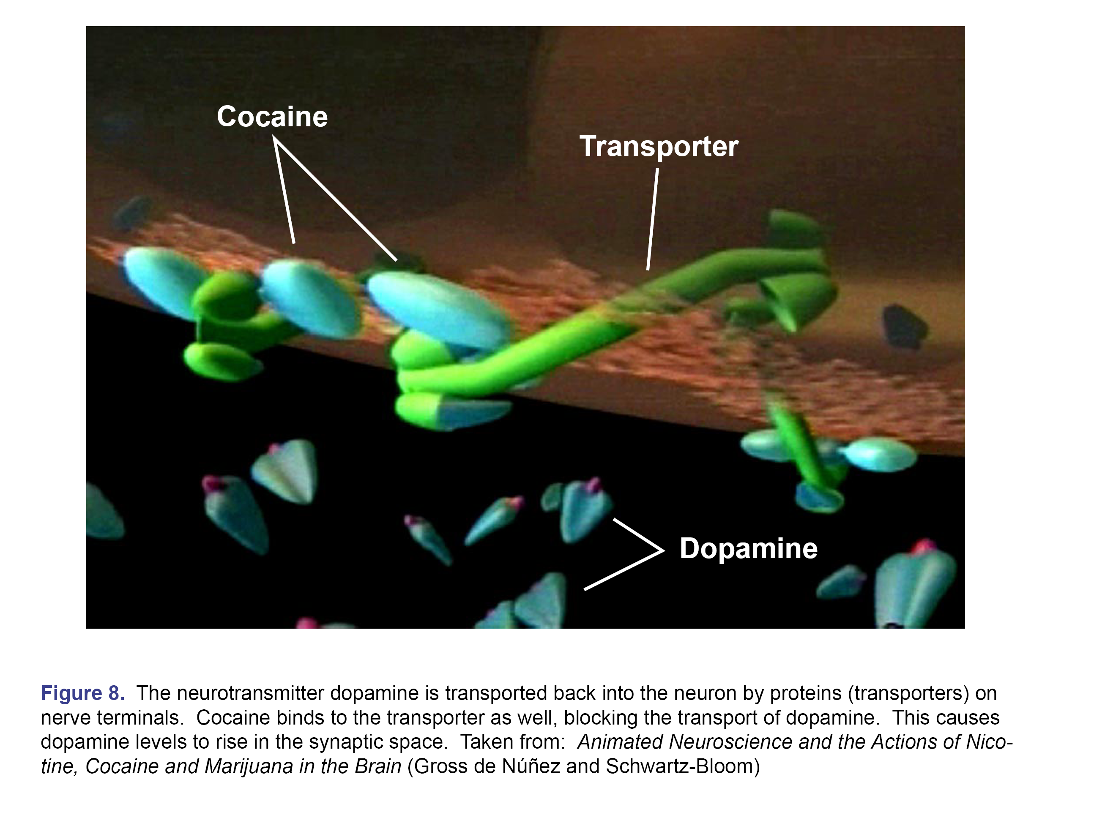

Slide 9
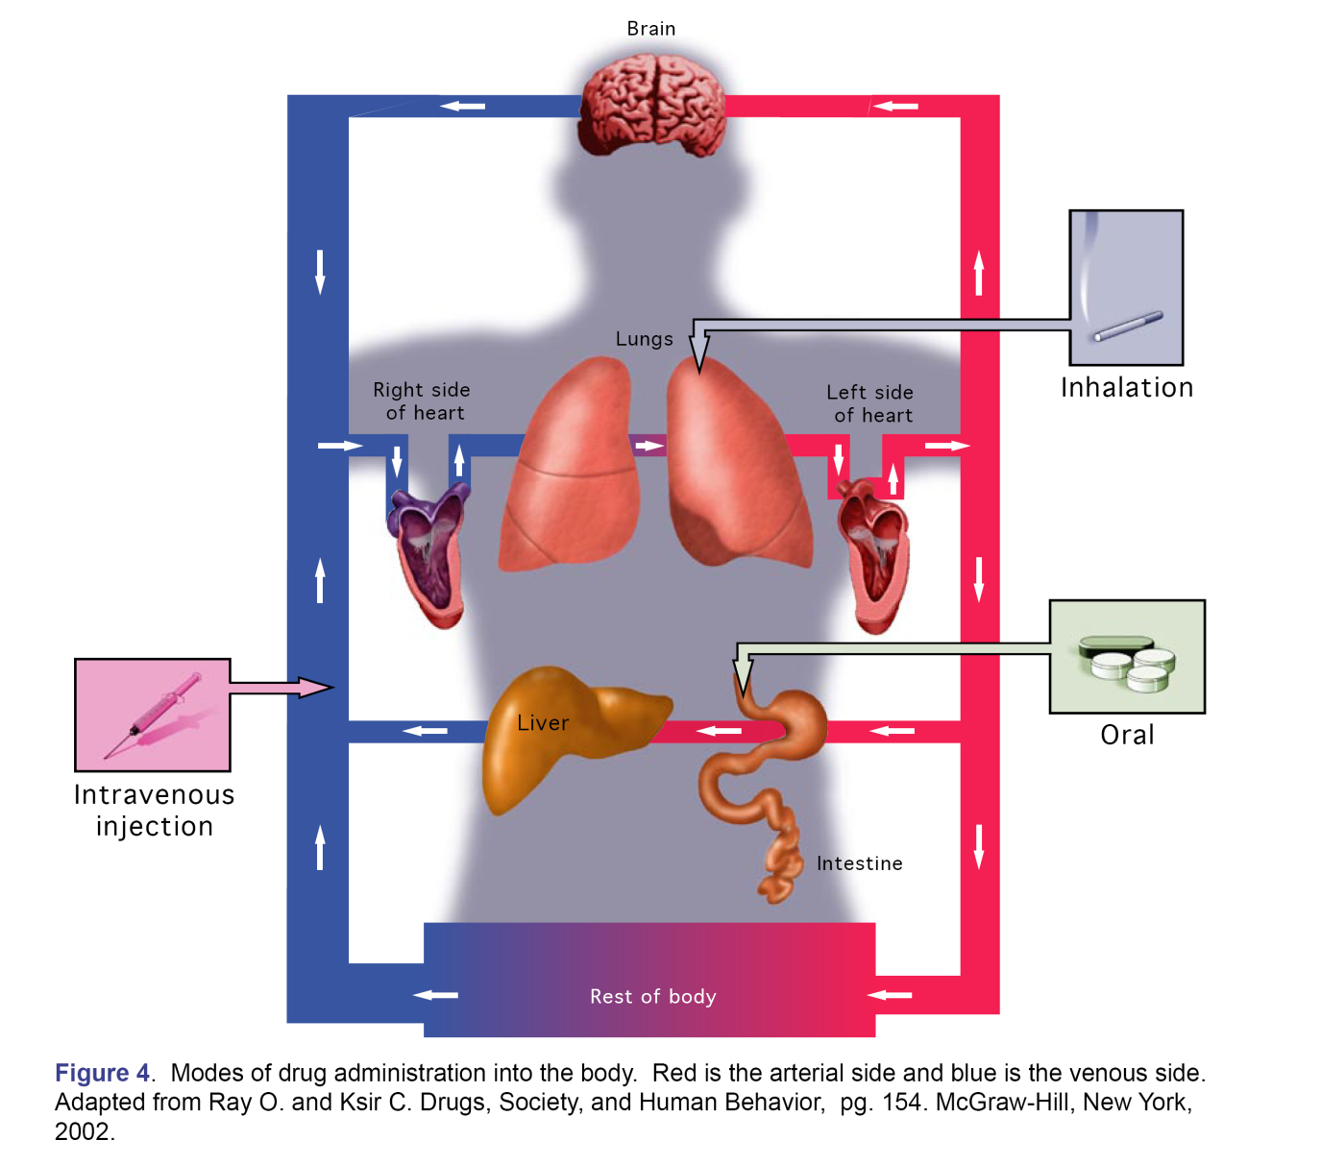
Modes of Drug Administration

Slide 10
Routes of Administration:
Injection into vein
Smoking
Snorted
Oral
Only lipid-loving compounds will gain access to the brain.
cocaine,
nicotine,
cannabis,
heroin.

Slide 11
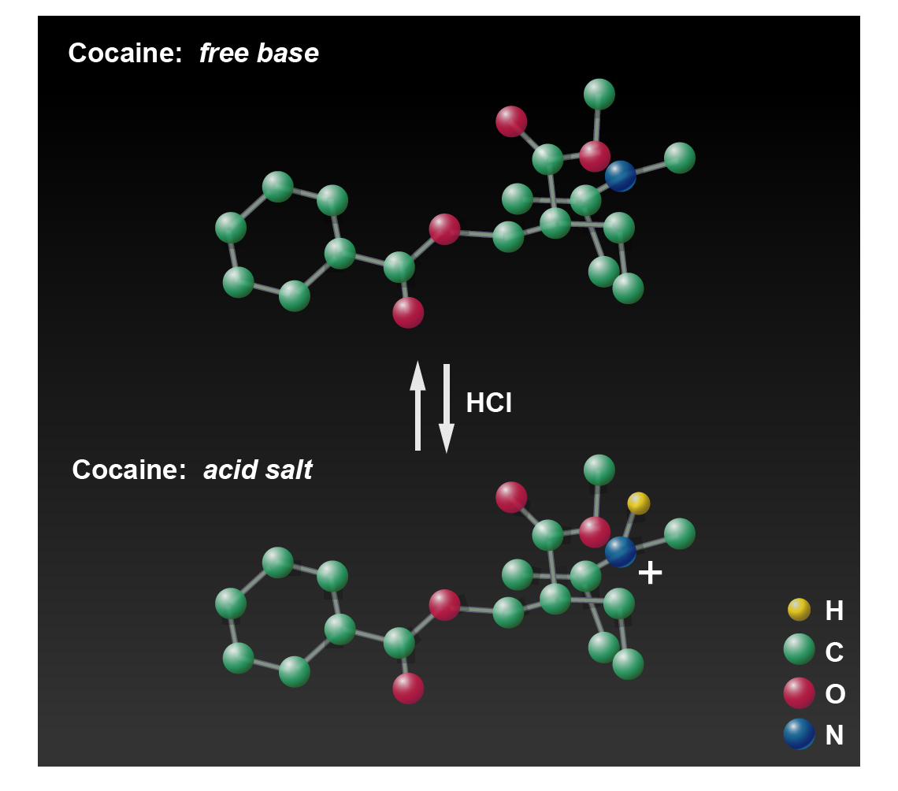
Cocaine:

Slide 12

Routes of Administration: Cocaine
Ionized form (salt) cannot be smoked because it is not stable at high temperatures and does not vaporize.
The un-ionized form (free base) is volatile at high temperature and can be smoked.
Free base is made by mixing the hydrochloride salt of cocaine with baking soda.
When the liquid mixture is evaporated, the solid can be crushed and heated up.
This is ‘CRACK’ cocaine.
Free base of heroin or amphetamine (‘ice’, ‘crystal meth’) are made in the same way

Slide 13
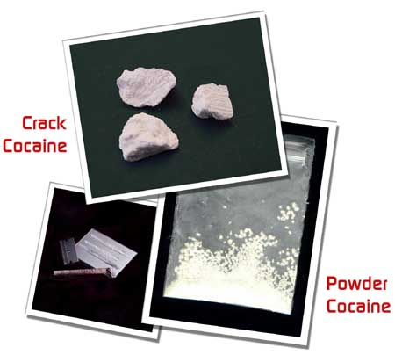
Routes of Administration of Cocaine:
Smoking (crack cocaine):
very rapid effects
maximum high
short lived
experience a ‘crash’ so repeat process.
Snorted
reaches brain more slowly – passes through the circulation first
less high
longer lived
less addictive

Slide 14
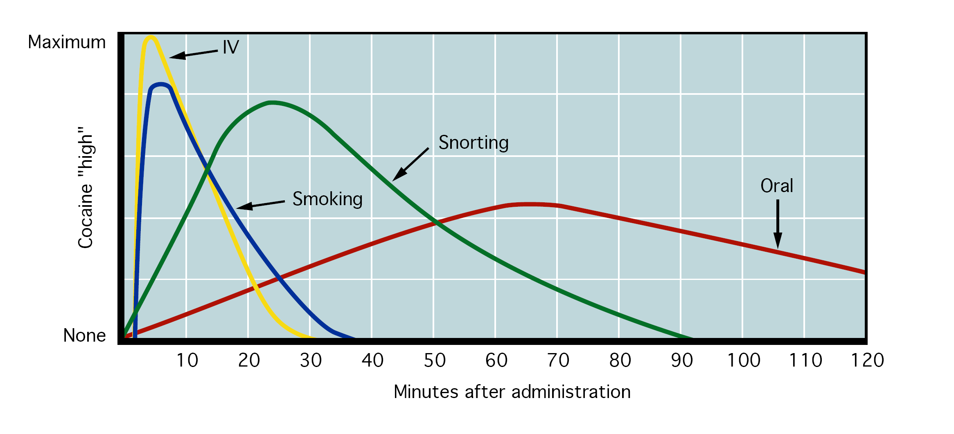
Relationship between the Routes of Administration of Cocaine
and the Euphoric Effects:

Slide 15
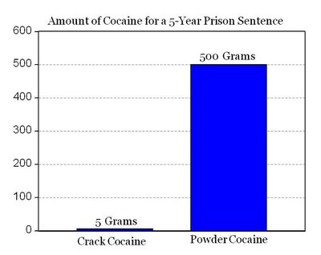
‘Finally, Some Relief for Double-Standard and Insane Drug Sentencing for Baking Soda’
From Economist Blog Dec 2007.
But is the only difference the ‘baking soda’??

Slide 16
Pharmacologic Agents
IOC-banned substance categories
Stimulants
Narcotic analgesics
Androgenic-anabolic steroids
β-Blockers
Diuretics
Peptide hormones and analogs
Substances that alter urine sample integrity

Slide 17
Adrenaline
Noradrenaline
α₁
α₂
β₁
β₂
Smooth muscle contraction
Smooth muscle contraction
Inhibition of neurotransmitter release
Heart muscle contraction
Smooth muscle relaxation
Agonists treat Asthma

Slide 18
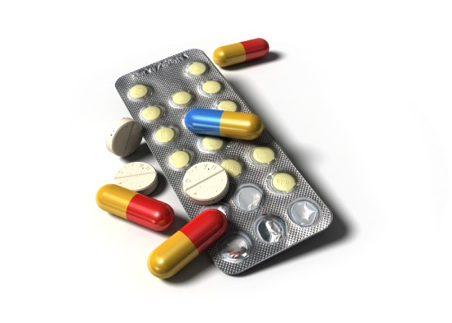

Clinical use of α antagonists
High blood pressure
Clinical use of β antagonists
High blood pressure
Angina
Migraine
Tremor
Anxiety

Slide 19
Beta Blockers
Block beta adrenergic receptors throughout the body i.e. so block part of sympathetic NS.
Used to treat hypertension, angina, cardiac arrhythmias, migraine, anxiety, tremor etc.
Have detrimental effects on exercise in both hypertensive and normotensive subjects due to decrease force and rate of heart, decreased BP, decreased vasodilatation in skeletal muscle, decreased airway diameter and decreased use of muscle triglycerides as energy source in prolonged exercise.
Most avoid them when exercising, but some subjects are so ill that benefits of drug outweigh any side-effects that may occur during exercise.

Slide 20
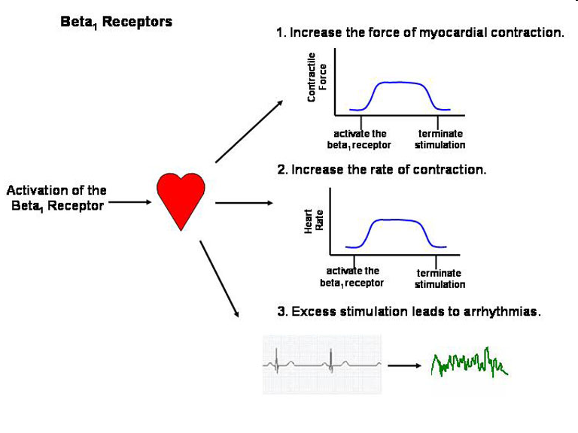
Beta (β) 1 Receptors - Cardiac
We often use beta blockers to treat cardiovascular problems as the heart cells express these receptors.
If we activate beta 1 receptors in the heart, it increases cardiac force and rate, thus increasing BP
If we block them, then we reduce these parameters – reduce BP in hypertension.
These are the receptors triggered by adrenaline during the fight or flight reaction – EXERCISE/EMERGENCY

Slide 21
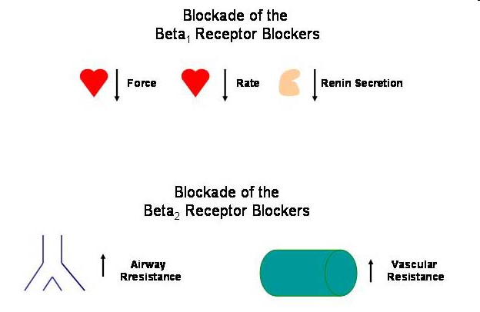
Why do we have to be careful with beta-blockers?
Useful effects for patients with CV disease, but make sure BP, HR, force of contraction don’t drop too much suddenly!
But BE CAREFUL!!
If you use a beta blocker that is non-selective i.e. it blocks both beta 1 and 2 receptors, then patients with asthma may not be able to dilate their airways when they use their inhalers! = ASPHYXIATION!!
Atenolol is often used in asthmatic patients who have cardiovascular problems as it has mainly beta 1 blocking activity, but little effect on respiratory beta 2. BETA-1 SELECTIVE.
Propranolol is a very useful drug, but blocks all beta receptors, thus asthmatics sometimes find that it produces breathing problems for them. NON-SELECTIVE BETA BLOCKER.

Slide 22
Abusing Beta Blockers
Some sports might find beta blockers beneficial, especially when they need a steady hand or aim e.g. archery, shooting, darts, javelin, etc
These can be drugs of abuse in these sports.
Slow HR, reduce skeletal muscle tremor.
Pistol shooting performance increased by 13.4% during beta-blockade.
Thought to be mainly due to decreased hand tremor not decreased HR.
Do not appear to affect auditory or visual reaction time, strength, power or muscular endurance in any beneficial way.

Slide 23
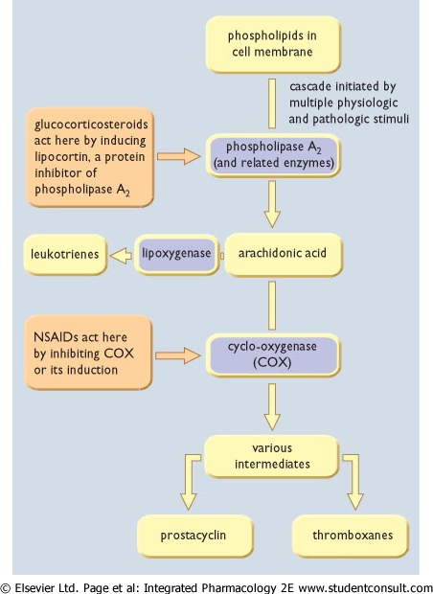
Steroidal Anti-inflammatory (NSAIDs)

Slide 24
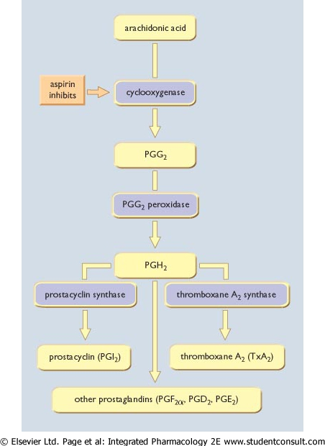
Non-steroidal Anti-inflammatory (NSAIDs)
Uses
Mask pain
Increase Training Capacity
Mark Injury Pain

Slide 25
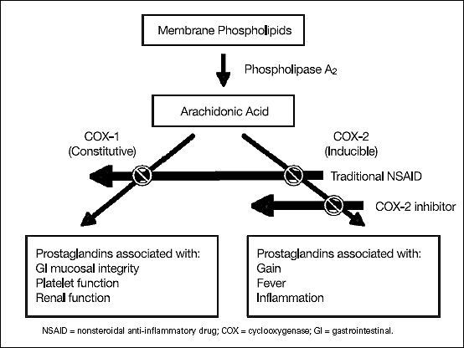

Slide 26
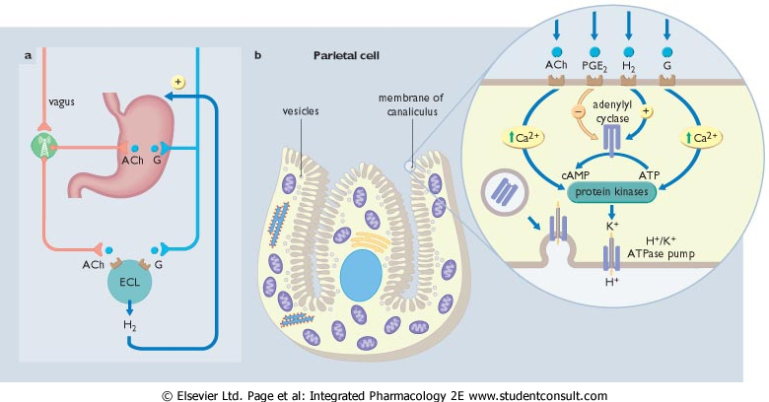
COX Inhibitors :
Prostaglandins (PGE2) produced in the GI tract PROTECT against damage and reduce acid production.

Slide 27

COX-1 selective or non selective Inhibitors :
Aspirin
Ibruprofen
Naproxen
Prostaglandins produced in the GI tract PROTECT against damage and reduce acid production.
COX-1 selective NSAIDs can increase risk of gastric ulcers and bleeding.
Heavy athletic training can increase gastric acid production – combined with NSADs the increases the RISK of ULCERS.

